Slide 1
PROJECT TITLE-REALTIME ACCENT TRANSLATION
PIP2001 Capstone Project
Review-1
Batch Number: CSG-G01
Roll Number | Student Name
20211CSG0011 | ZAINAB HANA
20211CSG0021 | PAWAN P
20211CSG0022 | RISHITH R RAI
20211CSG0027 | RAKSHITHA S
20211CSG0031 | GANASHREE P
Under the Supervision of,
Dr . SARAVANA KUMAR
Assistant Professor
School of Computer Science and Engineering
Presidency University
Name of the Program: B-TECH COMPUTER SCIENCE AND TECHNOLOGY
Name of the HoD: Dr. Saira Banu Atham
Name of the Program Project Coordinator: Dr. Manjula H M
Name of the School Project Coordinators: Dr. Sampath A K / Dr. Abdul Khadar A / Mr. Md Ziaur Rahman

Slide 2
INTRODUCTION
With globalization, communication across different linguistic and cultural backgrounds has become increasingly common, yet accents often present a challenge. It is also difficult to so ensure that spoken messages are accurately conveyed in familiar-sounding form, minimizing misunderstandings and fostering smoother interactions.
These systems analyze speech input, adapt to accent-specific phonetic patterns, and re-synthesize the speech with a more comprehensible or localized accent—all in real-time. Applications range from customer service and virtual meetings to live captioning, language learning platforms, and assistive technologies for individuals with hearing impairments.
This project aims to develop a real time accent translation system based on the recipients' and deliverer's accents. The idea is to achieve far better understanding during conference calls, which will make the communication far more effective.

Slide 3
LITERATURE REVIEW
Existing Systems:
Many current translation systems struggle with accent variations, impacting translation accuracy.
Previous studies highlight the importance of integrating accent detection and context-aware translation techniques.
Current systems integrate various data layers—acoustic, linguistic, and contextual—enabling the dynamic adaptation of accents in diverse communication platforms, whether for business, education, or entertainment.
Technological Advances:
Machine learning and NLP have improved speech recognition and translation, but real-time applications remain challenging.
Challenges Identified:
Latency issues during real-time translation hinder user experience.
The lack of personalization in voice and accent adaptation limits user acceptance.

Slide 4
LITERATURE REVIEW CONTD…
Research Gap:
Few systems effectively combine speech recognition, translation, and accent modification in real time.
Methods Overview:
Google Translate: Pros: Broad language and accent support. Cons: Struggles with strong regional accents and slang.
Speechmatics: Pros: Specialised in accent-independent speech recognition.
Cons: Primarily focused on transcription not translation.
Skype Translator: Pros: Learns and adapts to different accents over time.
Cons: Can introduce delay in conversion during complex speech.
Microsoft Translator: Pros: AI powered accent adaption.
Cons: Accuracy may drop for complex technical terms.
Vocre: Pros: Mobile-friendly, real time voice translation.
Cons: Struggles with strong accents or dialects.

Slide 5
PROPOSED METHOD
Develop a system integrating Speech-to-Text (STT), translation engine, and Text-to-Speech (TTS) functionalities.
Incorporate accent detection to tailor translations and synthesize speech in the user's preferred accent.
Use a MERN stack for the frontend and a lightweight Python script for backend processing.

Slide 6
OBJECTIVE
The main objective of a small-scale real-time accent translation project would be to develop an application that bridges the gap in understanding between individuals with different accents, facilitating smoother and more effective communication. Specifically, the project aims to create a lightweight system capable of recognizing various regional or national accents in real-time and converting them into a more neutral or familiar accent for the listener. This involves building an efficient model that can detect speech patterns, process them with minimal latency, and produce an output that retains the original meaning and tone, while simplifying or modifying the pronunciation for easier comprehension. Additionally, the project seeks to integrate user-friendly features, such as accent customization options, while ensuring accuracy, real-time performance, and low computational resource requirements, making it accessible for use in everyday devices or communication platforms.

Slide 7
METHODOLOGY
Data Collection: Gather audio samples from diverse accents.
Model Development: Train accent detection and translation models using collected data.
System Integration: Implement STT, translation, and TTS components using WebRTC for real-time communication.

Slide 8
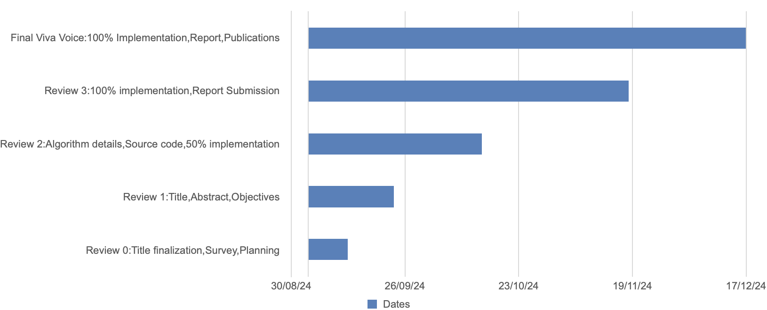
TIMELINE OF THE PROJECT(GANTT CHART)
PROJECT REVIEW:

Slide 9
EXPECTED OUTCOME
A fully functional real-time accent translation system with high accuracy and low latency.
Positive user feedback indicating improved communication in multilingual contexts.
Documentation for deployment and user guidance.

Slide 10
CONCLUSION
The proposed system addresses existing gaps in real-time translation technology by effectively integrating accent detection and modification.
It aims to enhance global communication, making it accessible for speakers of diverse accents.

Slide 11
REFERENCES
Zhang, J., & Wang, J. (2021). Deep learning for speech recognition: A survey. IEEE Access, 9, 135340-135362. https://doi.org/10.1109/ACCESS.2021.3110163
Hinton, G., Deng, L., Yu, D., Dahl, G. E., Mohamed, A. R., & Jaitly, N. (2012). Deep neural networks for acoustic modeling in speech recognition. IEEE Signal Processing Magazine, 29(6), 82-97. https://doi.org/10.1109/MSP.2012.2205597
Vaswani, A., Shazeer, N., Parmar, N., Uszkoreit, J., Jones, L., Kaiser, Ł., … & Polosukhin, I. (2017). Attention is all you need. Advances in Neural Information Processing Systems, 30. https://arxiv.org/abs/1706.03762
Deng, L., & Yu, D. - Speech Recognition with Neural Networks: A Review, 2009
Ververidis, D., & Kotropoulos, C. - Speech Emotion Recognition: A Review, 2006
Hinton, G., et al. - A Survey on Deep Learning Techniques for Speech Recognition, 2012
Zhang, Y., & Wu, H. - Multilingual Speech Recognition: An Overview, 2020

Slide 12


